Slide 1
Types of Cross-Country Fences

Slide 2
VERTICAL

Slide 3
Sloping Palisades

Slide 4
Narrow

Slide 5
Parallels

Slide 6
Table Top

Slide 7
Bench/ Chair

Slide 8
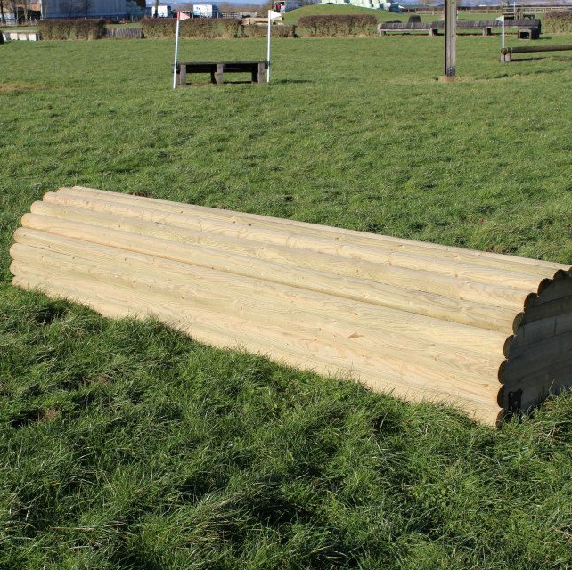
Roll Top

Slide 9
Brush Box

Slide 10
Bullfinch

Slide 11
Ramp

Slide 12
Steps

Slide 13
Trakehner

Slide 14
Water

Slide 15
Ditches

Slide 16
Sunken Road

Slide 17
Corner/ Apex

Slide 18
Drop

Slide 19
Log Piles

Slide 20
Bank

Slide 21
Elephant Traps

Slide 22
Roofs & Keyholes

Slide 23
Steeple Chase

Slide 24
Sharks Teeth

Slide 25
Triple Bars

